Slide 1


Slide 2
#1
among Ontario colleges for pathways
to other postsecondary institutions
10 CAMPUSES IN THE GTA, YORK REGION AND PETERBOROUGH
⁵⁰⁰⁺
^{CAREER OPTIONS}
30,000 FULL-TIME STUDENTS AND 70,000
^{PART-TIME REGISTRANTS}
^{SENECA IS HOME}
^{TO MORE THAN}
^{7,000 INTERNATIONAL}
^{STUDENTS FROM}
^{150 COUNTRIES}
^{9/10}
³⁰⁰⁺
^{PROGRAMS}
^{college graduates}
^{find jobs in their} ^{field}
^{190,000}
^{ALUMNI}
4,000+ STUDENTS MOVE BETWEEN SENECA AND ONTARIO UNIVERSITIES ANNUALLY

Slide 3

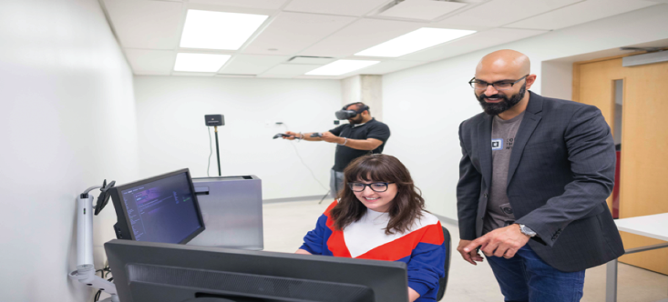




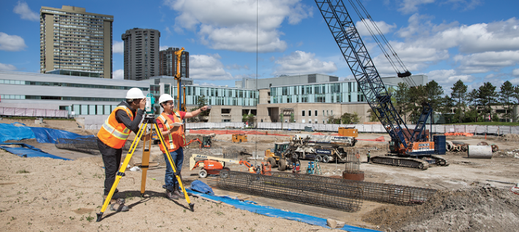





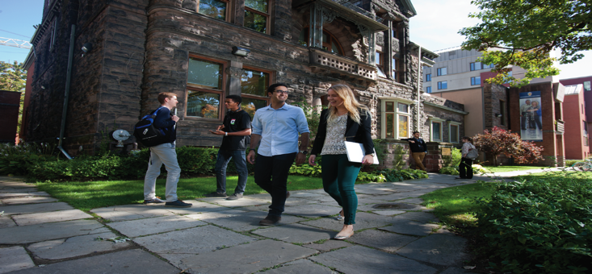


ADVANCED MANUFACTURING & SYSTEMS AUTOMATION
ARTS, ANIMATION & DESIGN
AVIATION
BUSINESS
BUSINESS – ACCOUNTING & FINANCE
COMMUNITY SERVICES
AREAS OF STUDY
ENGINEERING TECHNOLOGY
FASHION & ESTHETICS
HEALTH & WELLNESS
HOSPITALITY & TOURISM
INFORMATION & COMMUNICATIONS TECHNOLOGY
LAW, PUBLIC ADMINISTRATION & PUBLIC SAFETY
LIBERAL ARTS & SCIENCE AND UNIVERSITY TRANSFERS
MEDIA & COMMUNICATIONS
SCIENCE

Slide 4
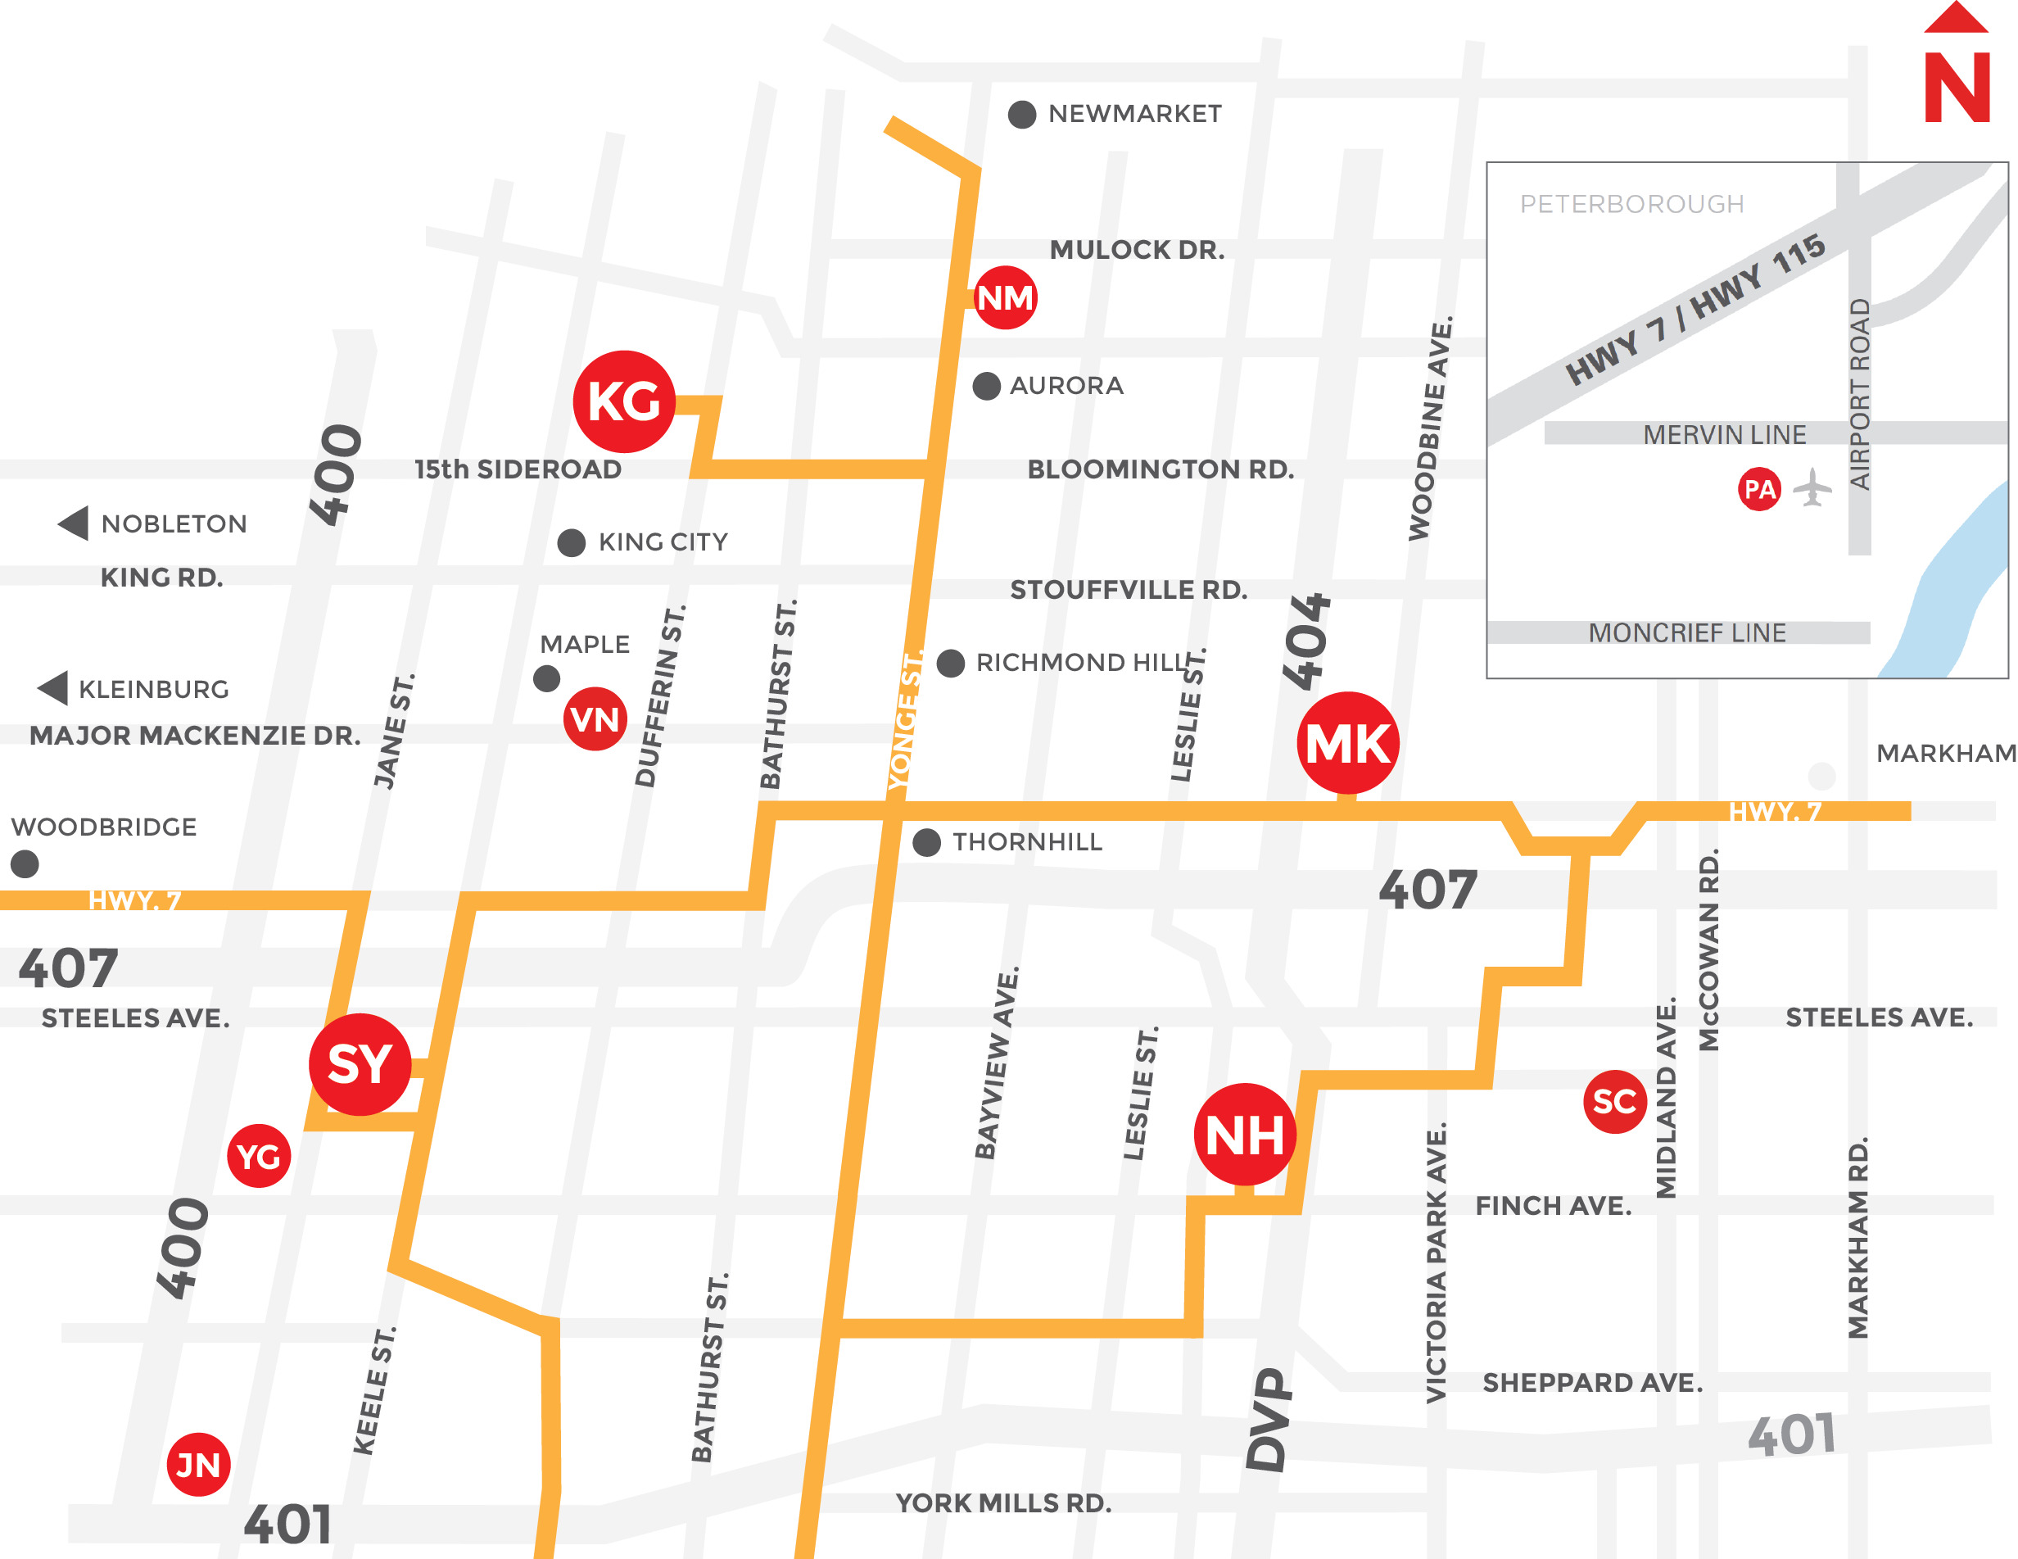
Where you’ll study
Notes:
The main campus buttons are clickable. When an campus button (ie; KG) is clicked it will go to the respective campus page. If you go to a campus page – you can get back to this page by clicking on the large image area.
If you choose to proceed without clicking on the campus buttons, you can use the page UP or DOWN buttons on the keyboard to proceed in a linear fashions.

Slide 5
Financial Aid
Scholarships, Bursaries & Awards
Work Study
OSAP
Notes:
Currently one of the largest college campuses in Canada
We have 10 campuses (Newnham, Markham, S@Y, King, Jane, Peterborough, Yorkgate and EO offices in Scarborough, Vaughan and Newmarket
27,500 full time students; 90k part-time students; 8K graduates a year
300+ programs
#1 College University Pathways

Slide 6
SESSION OVERVIEW
1 Estimated Expenses
2 Avoiding Debt
3 OSAP (Ontario Student Assistance Program)
4 BSWD (Students with Accommodations and IEPs)

Slide 7

What Is The Cost Of
Going To School?

Slide 8
ESTIMATED COSTS
TUITION
$1800 - $5000 per term
TEXTBOOKS
$500 - $1500 per term
ADDITIONAL
Transportation
Parking
Meal Plan
Health Plans
Personal Expenses
Residence
*Tuition rates vary by institution and program

Slide 9
Avoiding Debt
FUNDING STRATEGIES

Slide 10
Scholarships and Bursaries & Awards
Scholarships:
Bursaries:
Awards:
Merit based
Recognize a high level of excellence
Non-repayable
Financial need-based (non-academic standing)
Non-repayable
Combination of merit and financial need
Applications may also consider extra-curricular, volunteerism and demonstrated leadership or require references
  Applications may also consider extra-curricular, volunteerism and demonstrated leadership or require references

Slide 11
Scholarships and Bursaries & Awards
Institutional Awards/Bursaries include:
  Entrance: assessed and offered during the admission process
  Renewable Such as degree scholarships: based on maintenance of grades over several years
  In course: offered once a student is enrolled

Slide 12

Work Study Program: On Campus Employment
Work part-time while in school! On campus!
Positions are located on campuses
Designed to accommodate students’ academic schedules
Great way to stay connected, networking opportunities
Hourly wage can vary depending on the specifications of the job; at least legal minimum wage
To be eligible, must demonstrate financial need
* Search for work study opportunities during the summer and before the start of Fall term.
Notes:
For domestic and international students

Slide 13
WHAT IS OSAP?
ONTARIO STUDENT ASSISTANCE PROGRAM

Slide 14


OSAP
Ontario Student Assistance Program

Slide 15




What is OSAP?
The Ontario Student Assistance Program (OSAP) is funded by both the federal and provincial governments.
OSAP provides needs-based assistance through grants and loans to help qualified students with the cost of postsecondary studies.
Grants
Non-repayable aid (students keep)
Loans
    Repayable aid (students pay back)

Slide 16
Ontario Student Grant for eligible students
The new OSAP now makes tuition free or more affordable for hundreds of thousands of eligible students and allows more students to get a college or university education
Whether you’ve just graduated from high school or you’re an adult learner who wants to go to college or university:
  The new OSAP now provides more generous financial help than ever before.
  The new OSAP now benefits more people than ever before.
  The new OSAP isn’t just loans. You could also get grants that you don’t have to pay back
Find out how much you could get, try the quick OSAP calculator at ontario.ca/osap
Notes:
This is the free tuition you have heard about.

Slide 17

Who is eligible for OSAP?
To be eligible for OSAP, you must be:
  A Canadian citizen, permanent resident or protected person
  An Ontario resident
  Currently attending or entering an OSAP-approved program and school
  Currently enrolled in or entering a certificate, degree or diploma program that’s at least 12 weeks long

Slide 18







How is OSAP aid determined?
Educational
Costs
Financial
Contribution
Financial
Need
Tuition
Student
Books
Parent(s)
Living expenses
Scholarships and bursaries

Slide 19
When do I apply?
The 2018-19 OSAP Application for Full-Time Students is now available
Apply for OSAP 6 to 8 weeks before the start of your studies to avoid any delays.
Full-time Application deadline: You must submit your OSAP application no later than 60 days before the end of your study period.
Supporting documentation deadline: All supporting documents (e.g., signature and declaration pages, etc.) must be received no later than 40 days before the end of your study period.
Review deadline: All review request must be received no later than 40 days before the end of your study period.
Apply online at ontario.ca/osap.
Notes:
Processing time usually is 4 to 6 weeks at Seneca College.
If you apply for the Fall term, it is best to apply before June 30, 2017.

Slide 20
Steps to apply to OSAP
Go to ontario.ca/osap
Click “Apply” to register as a new user. You’ll create your OSAP profile and be assigned an OSAP Access Number (OAN)
In spring 2018, complete your application at ontario.ca/osap. You may need information from your parent(s) or spouse to submit your application.
After you submit your application, gather your required supporting documentation.
Upload, mail or deliver it in-person to your financial aid office right away to avoid processing delays.
Print your Master Student Financial Assistance Agreement (MSFAA). Sign and take it with your required ID to a designated Canada Post location.
Track the status of your application on your OSAP account. Check out your Message Centre for the latest information on your application, including how and when you’ll get your OSAP funding.

Slide 21
What information do I need to apply?
School & program
Personal SIN # & income amount for previous year and current monthly estimates
Spousal SIN # & income: for previous year
Parental SIN # & income if student wishes to apply for the Ontario Student Grant

Slide 22
Course Load
Full-time students : taking 60% or more of a full course load.
Part-time students : taking 20-59% of a full course load.
Students with a permanent disability:
  40%+ of a full course load = full-time student
  20-39% of a full course load = part-time student.

Slide 23
What else do I need to know about OSAP?
OSAP 2018 application is now open
You can have more than one OSAP application, for different schools or programs
Both full-time and part-time students can apply for OSAP.
You have to reapply for OSAP each academic year.
When you apply for OSAP, you can choose to receive only grant funding if you don’t want the loan.
If there are unexpected changes to your situation (program, income etc) after you apply make sure you update your application
Notes:
Unexpected changes may cause an overaward. Overawards are money previously issued but is now deemed unentitled and will be required to return the funding back.
Part-time is not interest free, assessed differently

Slide 24
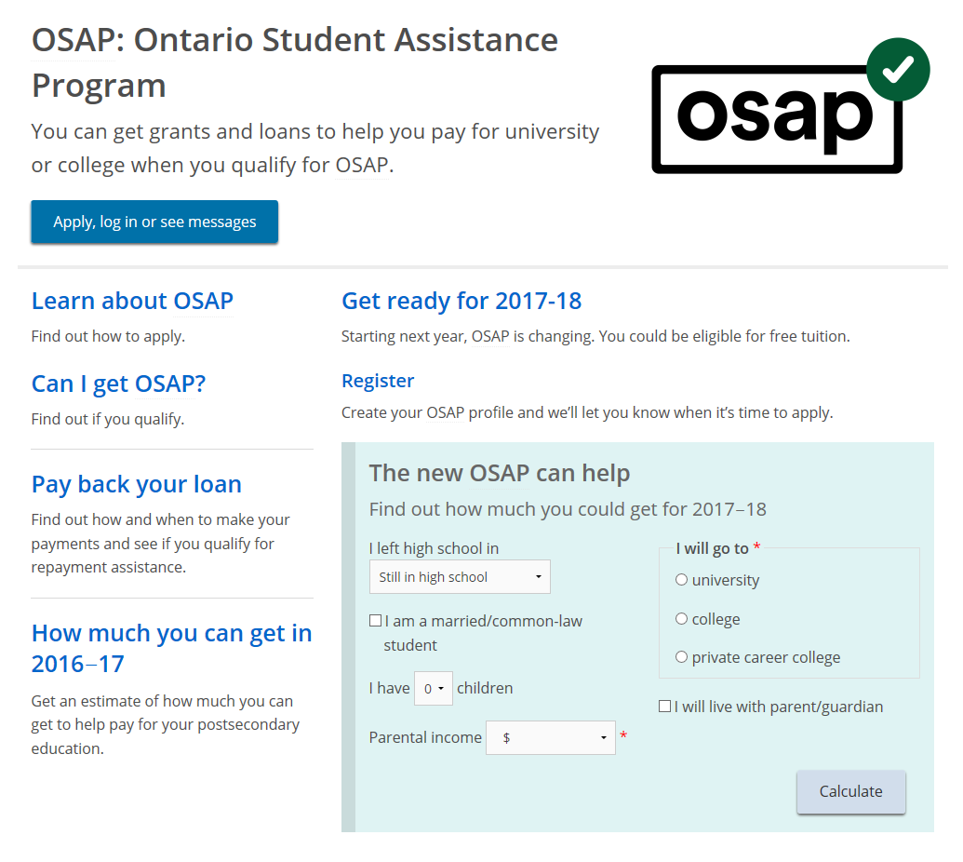
Ontario Student Assistance Program (OSAP)
Apply Here:
https://www.ontario.ca/page/osap-ontario-student-assistance-program

Slide 25
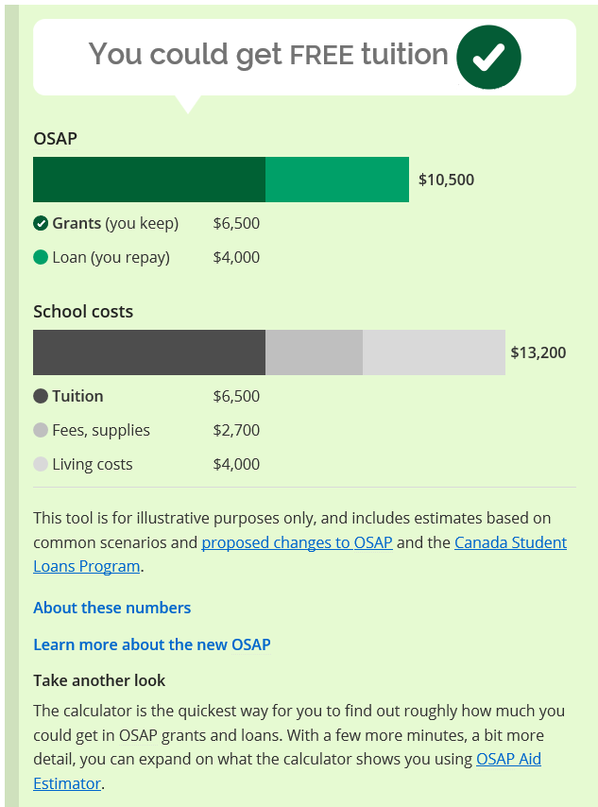
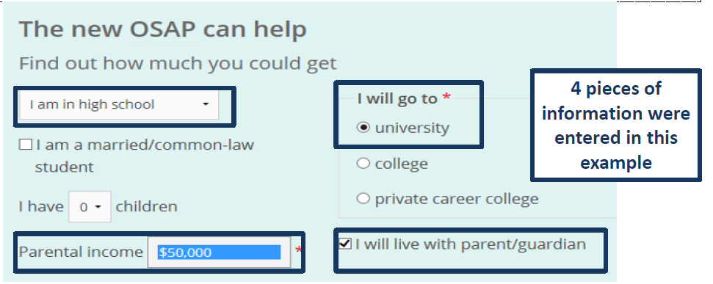
Example 1

Slide 26
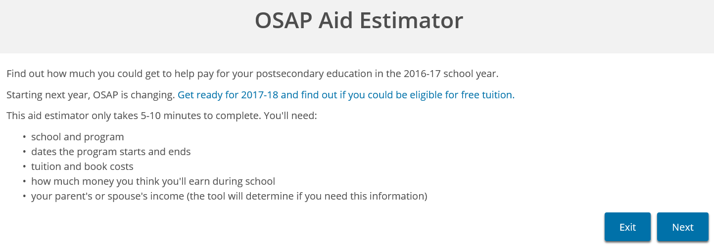
OSAP Aid Estimator
Gives students an estimate as to how much OSAP they may receive
Great way for student to budget for the year
https://osap.gov.on.ca/AidEstimatorWeb/enterapp/enter.xhtml?lang=en

Slide 27
Be Aware!!!
Things that can impact your OSAP entitlement and/or eligibility:
Changes in course load
Program changes
Failing to progress academically
Changes in your financial situation (or your family’s)
Withdrawing from studies

Slide 28
Bursary for Students with Disabilities and Canada Student Grant for Services and Equipment (BSWD)
You could be eligible:
If you demonstrate financial need through OSAP
If you are diagnosed with a permanent or temporary disability
If there is a need for a type of service and/or equipment could support your participation in post-secondary studies (as determined by your counsellor from your psycho educational assessment)
  Equipment examples: Laptop/desktop, voice recognition software, etc..
  Service examples: Notetaking, tutoring, educational assistance, therapy
Maximum is up to $10,000 per academic year
To apply, please schedule an appointment with the Counselling and Accessibility Office to determine what your needs are and potentially what you could quality for.

Slide 29
FINANCIAL AID
TIMELINE
6 STEPS TO FOLLOW

Slide 30
1 Determine which institution you are attending and accept offer of admission
2 Pay tuition deposit
3 Apply for OSAP and submit all documents
4 Permanent Disability Students – schedule an appointment with
Counseling and Accessibility Services at your postsecondary institution
5 Apply for Scholarships and Bursaries
6 Report any changes to financial aid and check statuses online

Slide 31
Dates to Know
ONTARIO COLLEGE INFORMATION FAIR – Enercare Center
Tuesday October 23, 2018
5:00 p.m. – 9:00 p.m.
Wednesday, October 24, 2018
9:00 a.m. – 2:00 p.m.
CAMPUS TOURS
Available year-round including special
March Break Campus Tours:
March 2019
For information or to book a tour:
www.senecacollege.ca/visitus
student.recruitment@senecacollege.ca
416.491.4660
OPEN HOUSE
Saturday, November 24, 2018
10:00 a.m. to 2:00 p.m.
Saturday, April 6, 2019
10:00 a.m. to 2:00 p.m.
Wednesday July 17, 2018
4:00 p.m. to 8:00 p.m.

Slide 32







See for yourself
See For Yourself
One-on-One Appointments
Campus Tours
Odeyto Centre
Open Houses
Program Spotlights
Webinars
Weekly Online Q&A Sessions
416.491.4660
student.recruitment@senecacollege.ca
#StartAtSeneca
Notes:
Odeyto is an Annishnaabe word for the good journey, representative of the journey the Indigenous students take upon arrival to Seneca.

Slide 33


